Slide 1


stars Singapore symposium 2019

Slide 2

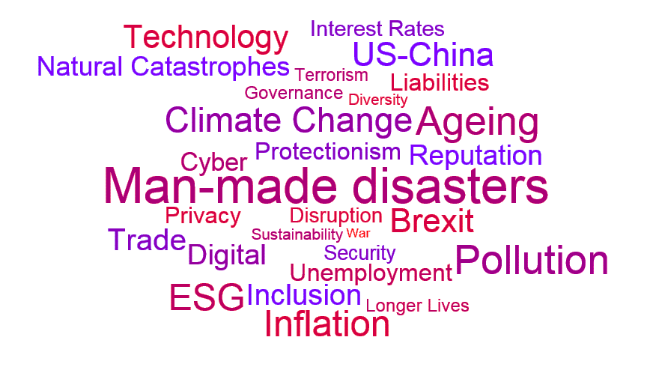

Slide 3

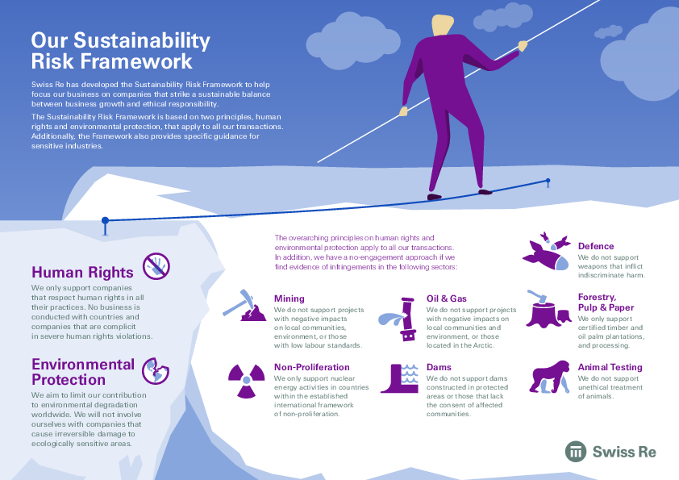
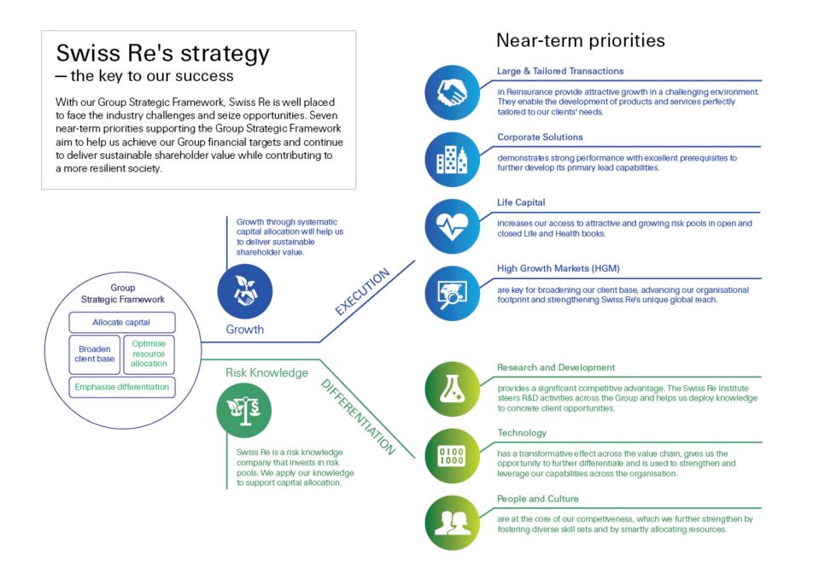
Frameworks and tools help us navigate…

Slide 4


Global Leadership Examples of real life
Filtering the noise
Moving between the micro and the macro
Translating global to local
Complex relationships
Long term vs. short term
4

Slide 5

Preparing for the Future What should leaders think about?
Resilience
Personal
Professional
Business
Workforce
Motivation
Career cycles
Technology impacts
Trends
Spot and build for the future
Be agile and ahead of the change

Slide 7
Legal notice
©2019 Swiss Re. All rights reserved. You are not permitted to create any modifications or derivative works of this presentation or to use it for commercial or other public purposes without the prior written permission of Swiss Re.
The information and opinions contained in the presentation are provided as at the date of the presentation and are subject to change without notice. Although the information used was taken from reliable sources, Swiss Re does not accept any responsibility for the accuracy or comprehensiveness of the details given. All liability for the accuracy and completeness thereof or for any damage or loss resulting from the use of the information contained in this presentation is expressly excluded. Under no circumstances shall Swiss Re or its Group companies be liable for any financial or consequential loss relating to this presentation.

