Slide 1
ASEAN: trends and implications
Prakash Kannan
Deputy chief economist
Head, total portfolio management
Gic

Slide 2
Three key points
While global growth remains the key driver of ASEAN growth, the nature of relationships is changing
Domestic macro management has increased resilience
The resilience that has been built for what is likely to be challenging times ahead

Slide 3
ASEAN: changing correlations

Slide 4
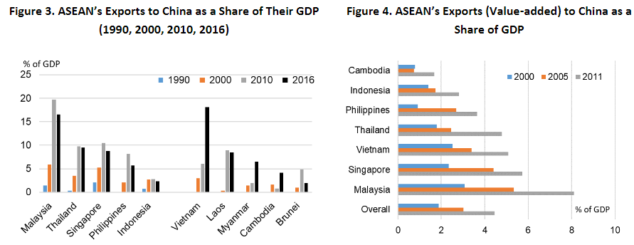
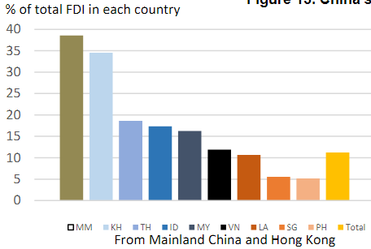
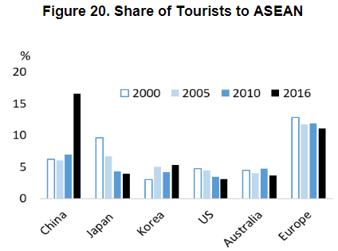
Increasing ties with china
Source: IMF, AMRO

Slide 5
A bumpy ride

Slide 6
Improved macro management have made economies more resilient
Broad adoption of inflation targeting framework for monetary policy
Development of local currency bond market
Higher international reserve balances
Lower current account deficits

Slide 7
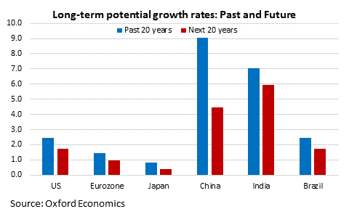
Demographics & weak productivity weigh on trend growth

Slide 8
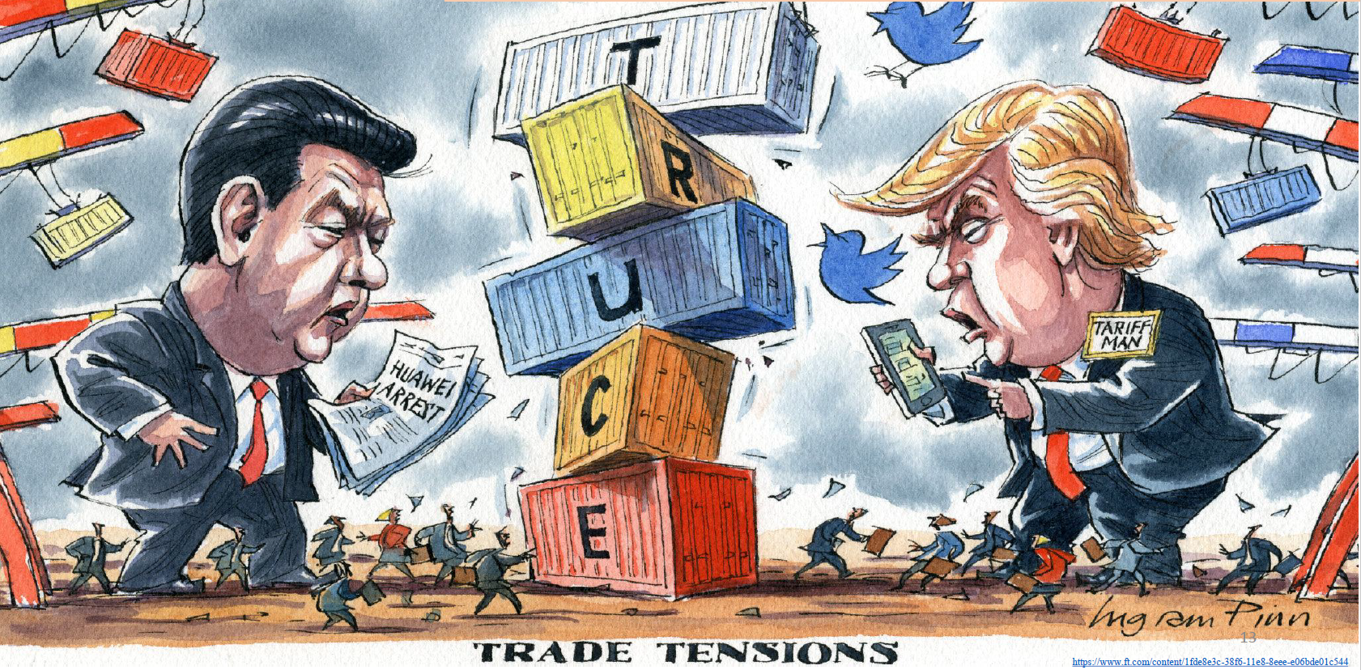
US-china relations is a key uncertainty for region

Slide 9
Additional challenges
Waning demographic dividend
Comparative advantage fading as wages are rising in more advanced ASEAN nations
Automation and robotics are reducing demand for relatively unskilled labour

Slide 10
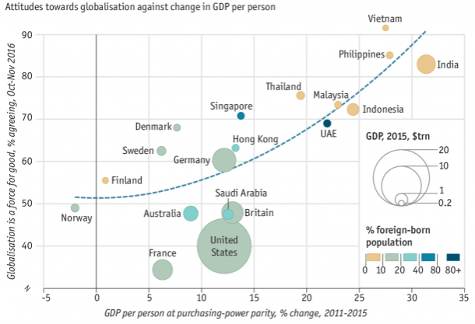
Silver lining: Attitudes to globalization
ASEAN region has very favourable views towards globalization

Slide 11
Three key points
While global growth remains the key driver of ASEAN growth, the nature of relationships is changing
Domestic macro management has increased resilience
The resilience that has been built for what is likely to be challenging times ahead

