Slide 1

stars Singapore symposium 2019
Future-ready Asia
27 February - 2 March 2019
Singapore, Changi Cove
Welcome Address
Dr. Toni Schoenenberger, Executive Chairman, stars Foundation Board
Singapore, 27 February 2019

Slide 2
23 Nationalities
Australia
Chile
China
Costa Rica
France
Germany
Great Britain
India
Indonesia
Kazakhstan
Korea
Malaysia
Mongolia
Nepal
Japan
Serbia
Singapore
Spain
Switzerland
The Philippines
Timor-Leste
Turkey
United States

Slide 3
Gender
59% men
41% women

Slide 4
Professional Background

Slide 5
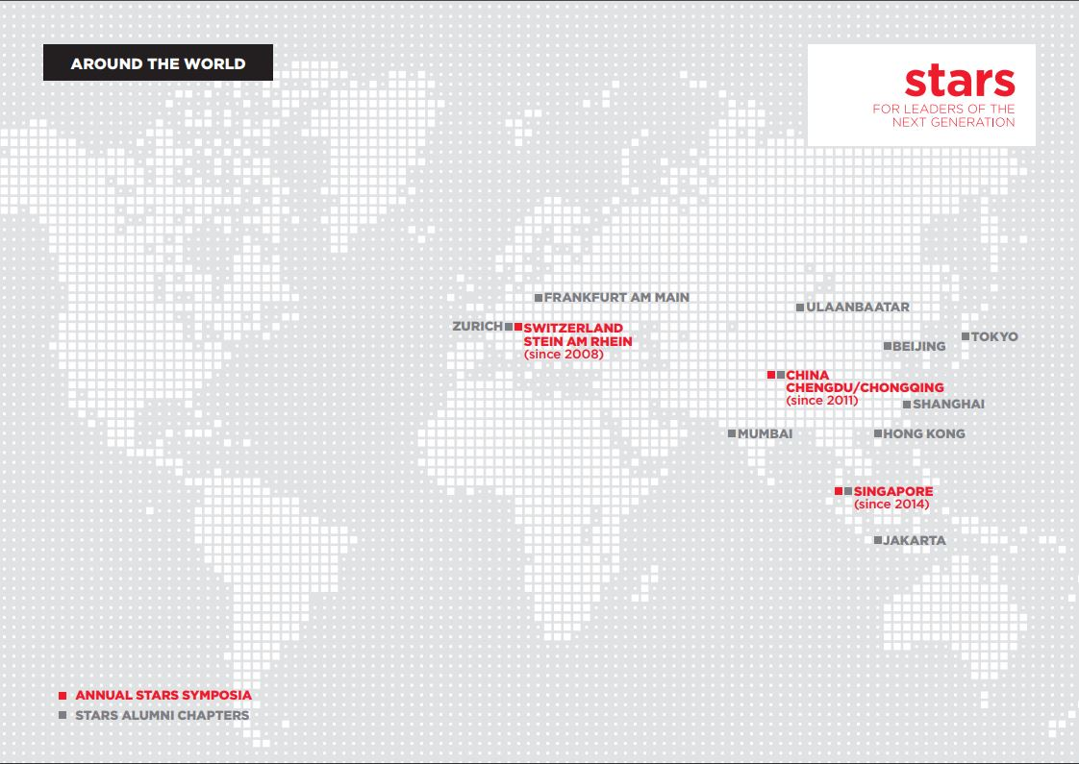

Slide 6
stars alumni network
> 2’000 alumni from more than 100 countries
> 300 moved into Group Executive Committees or similar functions
Alumni newsletters
stars LinkedIn group
Weekly publication of stars insights
11 regional stars alumni chapters
stars alumni study tours:
  2017: Indonesia, Mongolia
  2018: Cambodia
  2019: Saudi Arabia, Dresden/Germany
  2020: Nepal
  2021: Kazakhstan
  Tbc: The Philippines, Vietnam, Myanmar

Slide 7


Slide 8
