Slide 1



The Future of Artificial Intelligence: Ethics & Good Governance
Yeong Zee Kin
Deputy Commissioner, Personal Data Protection Commission
Assistant Chief Executive, Data Innovation & Protection Group
Infocomm Media Development Authority of Singapore

Slide 2
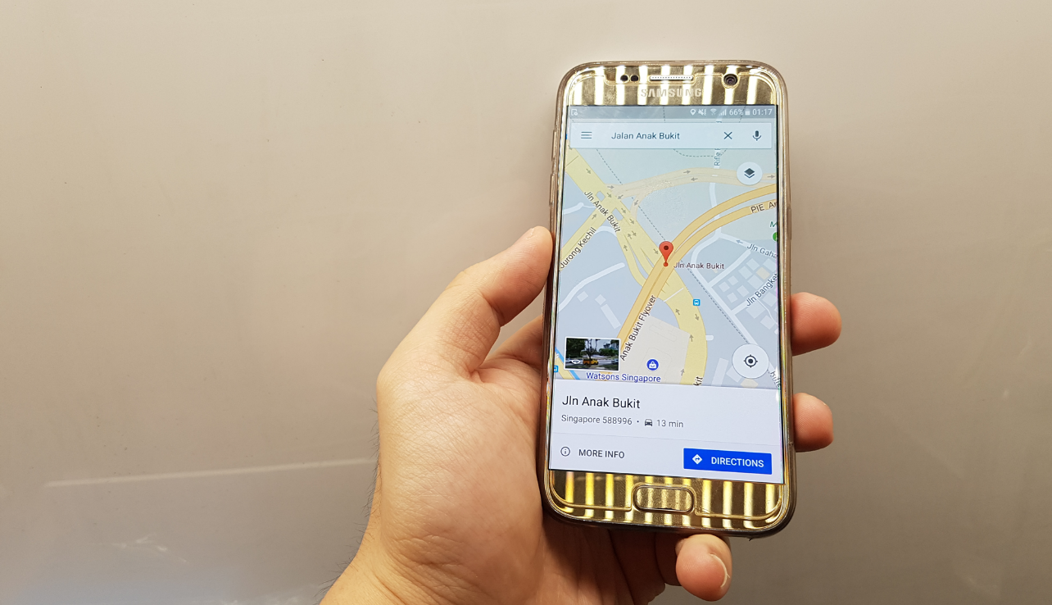
SEIZING OPPORTUNITIES
  APPLYING ETHICS TO ARTIFICIAL INTELLIGENCE
  RESPONSIBLE DEPLOYMENT TO INSPIRE PUBLIC CONFIDENCE
  NEW PRODUCT OFFERINGS, DYNAMIC FEATURES AND SERVICE IMPROVEMENTS
  ECONOMIC GROWTH AND BETTER QUALITY OF LIFE

Slide 3




CHALLENGES IN RESPONSIBLE AI
Consumer Knowledge
Unintended Discrimination
Lack of Transparency

Slide 4

AI DEVELOPMENT AND ADOPTION
  SUPPORTING THROUGH GOVERNANCE AND ETHICS
  BRINGING RELEVANT STAKEHOLDERS TOGETHER TO BUILD A TRUSTED ECOSYSTEM
  MODEL GOVERNANCE FRAMEWORKS FOR VOLUNTARY ADOPTION
  FUNDING RESEARCH TO IDENTIFY AND CREATE SOLUTIONS

Slide 5

A BALANCED GOVERNANCE FRAMEWORK
TO ENGENDER TRUST AND ENABLE INNOVATION
  ACCOUNTABILITY-BASED FRAMEWORK
  AI ETHICS INTO CORPORATE GOVERNANCE AND RISK MANAGEMENT STRUCTURES
  TRANSLATING RESPONSIBLE AI FROM PRINCIPLES TO PROCESSES
  ESTABLISHING GOOD CONSUMER INTERACTIONS

Slide 6
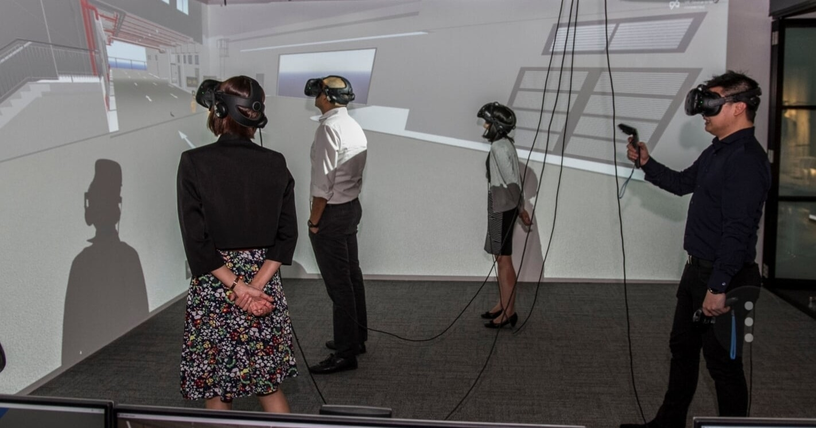
GUIDING PRINCIPLES
  FOR RESPONSIBLE AI
  DECISIONS (TRANSPARENT, EXPLAINABLE, FAIR)
  AI SYSTEMS (HUMAN-CENTRIC, SAFETY)

Slide 7




MODEL AI GOVERNANCE FRAMEWORK
APPLYING THE FRAMEWORK
Stage 1
Corporate Governance
Stage 2
Risk Management
Stage 3
Operations Management
Stage 4
Customer Relationships

Slide 8



MODEL AI GOVERNANCE FRAMEWORK
OVERVIEW OF THE FRAMEWORK
Internal Governance Structures & Measures
Corporate governance structures, decision making models, oversight mechanisms, monitoring & reporting systems, periodic review
Risk Management in AI Decision-Making
Risk & impact assessments incorporating ethical considerations
Degree of human intervention in AI decision-making
Periodic review
Operations Management
Data curation, model formulation, model selection, training & tuning as phases
Seeks to ensure quality, source, veracity, while mitigating inherent bias
Customer Relationship Management
Build & maintain open relationship with customer that builds trust
Feedback channels

Slide 9

Thank You
www.imda.gov.sg / www.pdpc.gov.sg

